Slide 1
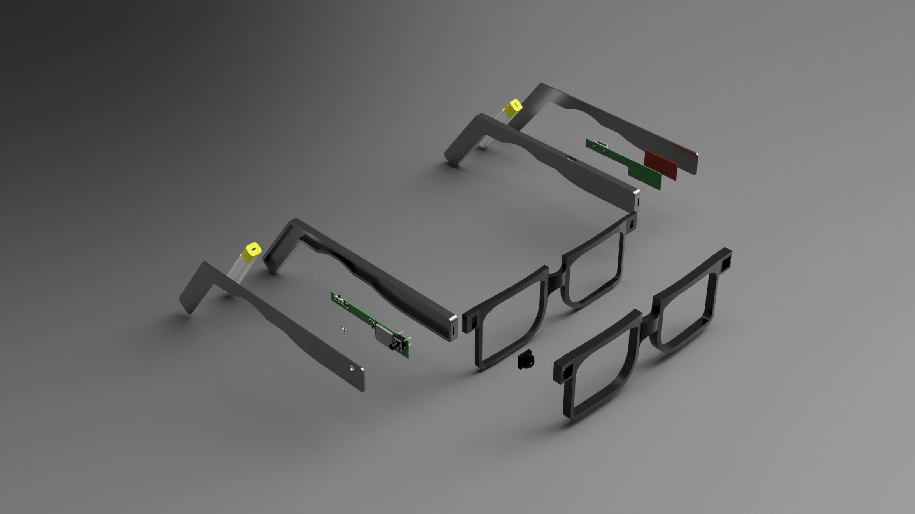
Right & Left Arms
Batteries
Arm Covers
Custom PCB’S
Antenna
Programmable touchpad
Frame Covers
Camera
Frames

